Slide 1
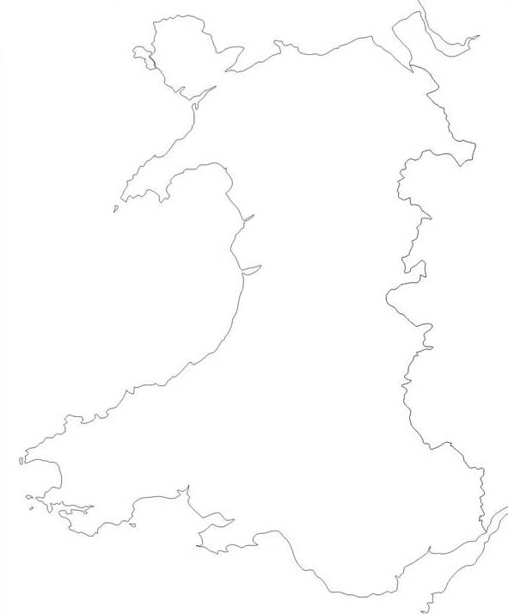
Physical Features of Wales
1
Island
Isle of Anglesey
Mountains
Snowdonia
Brecon Beacons
Cambrian Mountains
Peninsulas
Pembrokeshire
Gower
LLŷn
Inlets
Bristol Channel
Cardigan Bay
3
2
4
5
6
7
9
8

Slide 2
Physical Features of Wales
1
Island
Isle of Anglesey
Mountains
Snowdonia
Brecon Beacons
Cambrian Mountains
Peninsulas
Pembrokeshire
Gower
LLŷn
Inlets
Bristol Channel
Cardigan Bay
3
2
4
5
6
7
9
8

